Slide 1

Chapter 5
Multiple Discriminant Analysis and Logistic Regression
Copyright © 2007
Prentice-Hall, Inc.

Slide 2
Chapter 5: Multiple Discriminant Analysis
and Logistic Regression
LEARNING OBJECTIVES:
Upon completing this chapter, you should be able to do the following:
State the circumstances under which a linear discriminant analysis or logistic regression should be used instead of multiple regression.
Identify the major issues relating to types of variables used and sample size required in the application of discriminant analysis.
Understand the assumptions underlying discriminant analysis in assessing its appropriateness for a particular problem.
Describe the two computation approaches for discriminant analysis and the method for assessing overall model fit.
Explain what a classification matrix is and how to develop one, and describe the ways to evaluate the predictive accuracy of the discriminant function.
Tell how to identify independent variables with discriminatory power.
Justify the use of a split-sample approach for validation.
Understand the strengths and weaknesses of logistic regression compared to discriminant analysis and multiple regression.
Interpret the results of a logistic regression analysis, with comparisons to both multiple regression and discriminant analysis.

Slide 3
Discriminant Analysis Defined
Multiple discriminant analysis . . . is an appropriate technique when the dependent variable is categorical (nominal or nonmetric) and the independent variables are metric. The single dependent variable can have two, three or more categories.
Examples:
Gender – Male vs. Female
Heavy Users vs. Light Users
Purchasers vs. Non-purchasers
Good Credit Risk vs. Poor Credit Risk
Member vs. Non-Member
Attorney, Physician or Professor

Slide 4
Survey Results for the Evaluation*
of a New Consumer Product
Purchase Intention
Subject Number
X₁ Durability
X₂ Performance
X₃
Style
Group 1
Would purchase 1 8 9 6
2 6 7 5
3 10 6 3
4 9 4 4
5 4 8 2
Group Mean 7.4 6.8 4.0
Group 2
Would not purchase 6 5 4 7
7 3 7 2
8 4 5 5
9 2 4 3
10 2 2 2
Group Mean 3.2 4.4 3.8
Difference between group means 4.2 2.4 0.2
*Evaluations made on a 0 (very poor) to 10 (excellent) rating scale.

Slide 5
Graphic Illustration of
Two-Group Discriminant Analysis
X₂
A
B
A’
B’
X₁
Discriminant Function
Z

Slide 6
Discriminant Analysis Decision Process
Stage 1: Objectives of Discriminant Analysis
Stage 2: Research Design for Discriminant Analysis
Stage 3: Assumptions of Discriminant Analysis
Stage 4: Estimation of the Discriminant Model and Assessing Overall Fit
Stage 5: Interpretation of the Results
Stage 6: Validation of the Results

Slide 7
Stage 1: Objectives of Discriminant Analysis
Determine if statistically significant differences exist between the two (or more) a priori defined groups.
Identify the relative importance of each of the independent variables in predicting group membership.
Establish the number and composition of the dimensions of discrimination between groups formed from the set of independent variables. That is, when there are more than two groups, you should examine and "name" each significant discriminant function. The number of significant functions determines the "dimensions"/discriminant functions and what they represent in distinguishing the groups.
Develop procedures for classifying objects (individuals, firms, products, etc.) into groups, and then examining the predictive accuracy (hit ratio) of the discriminant function to see if it is acceptable (> 25% increase).

Slide 8
Stage 2: Research Design for Discriminant Analysis
Selection of dependent and independent variables.
Sample size (total & per variable).
Sample division for validation.

Slide 9
Converting Metric Variables to Nonmetric
Most common approach = to use the metric scale responses to develop nonmetric categories. For example, use a question asking the typical number of soft drinks consumed per day and develop a three-category variable of 0 drinks for non-users, 1 – 5 for light users, and 5 or more for heavy users.
Polar extremes approach = compares only the extreme two groups and excludes the middle group(s).

Slide 10
Rules of Thumb 5–1
Discriminant Analysis Design
The dependent variable must be nonmetric, representing groups of objects that are expected to differ on the independent variables.
Choose a dependent variable that:
  best represents group differences of interest,
  defines groups that are substantially different, and
  minimizes the number of categories while still meeting the research objectives.
In converting metric variables to a nonmetric scale for use as the dependent variable, consider using extreme groups to maximize the group differences.
Independent variables must identify differences between at least two groups to be of any use in discriminant analysis.

Slide 11
Rules of Thumb 5–1 Continued . . .
The sample size must be large enough to:
  have at least one more observation per group than the number of independent variables, but striving for at least 20 cases per group.
  have 20 cases per independent variable, with a minimum recommended level of 5 observations per variable.
  have at least one more observation per group than the number of independent variables, but striving for at least 20 cases per group.
  have a large enough sample to divide it into an estimation and holdout sample, each meeting the above requirements.
The most important assumption is the equality of the covariance matrices, which impacts both estimation and classification.
Multicollinearity among the independent variables can markedly reduce the estimated impact of independent variables in the derived discriminant function(s), particularly if a stepwise estimation process is used.

Slide 12
Stage 3: Assumptions of Discriminant Analysis
Key Assumptions
Multivariate normality of the independent variables.
Equal variance and covariance for the groups.

Slide 13
Stage 3: Assumptions of Discriminant Analysis
Other Assumptions
Minimal multicollinearity among independent variables.
Group sample sizes relatively equal.
Linear relationships.
Elimination of outliers.

Slide 14
Stage 4: Estimation of the Discriminant Model and Assessing Overall Fit
Selecting An Estimation Method:
Simultaneous Estimation – all independent variables are considered concurrently.
Stepwise Estimation – independent variables are entered into the discriminant function one at a time.

Slide 15
Estimating the Discriminant Function
The stepwise procedure begins with all independent variables not in the model, and selects variables for inclusion based on:
  Statistically significant differences across the groups (.05 or less required for entry), and
  The largest Mahalanobis distance (D²) between the groups.

Slide 16
Assessing Overall Model Fit
Calculating discriminant Z scores for each observation,
Evaluating group differences on the discriminant Z scores, and
Assessing group membership prediction accuracy.

Slide 17
Assessing Group Membership Prediction Accuracy
Major Considerations:
The statistical and practical rational for developing classification matrices,
The cutting score determination,
Construction of the classification matrices, and
Standards for assessing classification accuracy.

Slide 18
Rules of Thumb 5–2
Model Estimation and Model Fit
While stepwise estimation may seem “optimal” by selecting the most parsimonious set of maximally discriminating variables, beware of the impact of multicollinearity on the assessment of each variable’s discriminatory power.
Overall model fit assesses the statistical significance between groups on the discriminant Z score(s), but does not assess predictive accuracy.
With more than two groups, do not confine your analysis to only the statistically significant discriminant function(s), but consider if nonsignificant functions (with significance levels of up to .3) add explanatory power.

Slide 19
Calculating the Optimum Cutting Score
Issues:
Define the prior probabilities based either on the relative sample sizes of the observed groups or specified by the researcher (either assumed to be equal or with values set by the researcher), and
Calculate the optimum cutting score value as a weighted average based on the assumed sizes of the groups (derived from the sample sizes).

Slide 20
Establishing Standards of Comparison for the Hit Ratio
Group sizes determine standards based on:
Equal Group Sizes
Unequal Group Sizes – two criteria:
  Maximum Chance Criterion
  Proportional Chance Criterion

Slide 21
Classification Matrix
HBAT’s New Consumer Product
Predicted Group
Would
Not
Purchase
Percent
Correct
Classification
Actual
Group
Would
Purchase
Actual
Total
(1) 22 3 25 88%
(2) 5 20 25 80%
Predicted Total
27 23 50
Percent Correctly Classified (hit ratio) =
100 x [(22 + 20)/50] = 84%

Slide 22
Rules of Thumb 5–3
Assessing Predictive Accuracy
The classification matrix and hit ratio replace R² as the measure of model fit:
  assess the hit ratio both overall and by group..
  If the estimation and analysis samples both exceed 100 cases and each group exceeds 20 cases, derive separate standards for each sample. If not, derive a single standard from the overall sample.
Analyze the missclassified observations both graphically (territorial map) and empirically (Mahalanobis D²).

Slide 23
Rules of Thumb 5–3 Continued . . .
Assessing Predictive Accuracy
There are multiple criteria for comparison to the hit ratio:
  The maximum chance criterion for evaluating the hit ratio is the most conservative, giving the highest baseline value to exceed.
  Be cautious in using the maximum chance criterion in situations with overall samples less than 10 and/or group sizes under 20.
  The proportional chance criterion considers all groups in establishing the comparison standard and is the most popular.
  The actual predictive accuracy (hit ratio) should exceed the any criterion value by at least 25%.

Slide 24
Stage 5: Interpretation of the Results
Three Methods:
Standardized discriminant weights,
Discriminant loadings (structure correlations), and
Partial F values.

Slide 25
Interpretation of the Results
Two or More Functions:
Rotation of discriminant functions.
Potency index.

Slide 26
Graphical Display of Discriminant Scores and Loadings
Territorial Map = most common method.
Vector Plot of Discriminant Loadings, preferably the rotated loadings = simplest approach.

Slide 27
Plotting Procedure for Vectors
Three Steps:
Selecting variables,
Stretching the vectors, and
Plotting the group centroids.

Slide 28
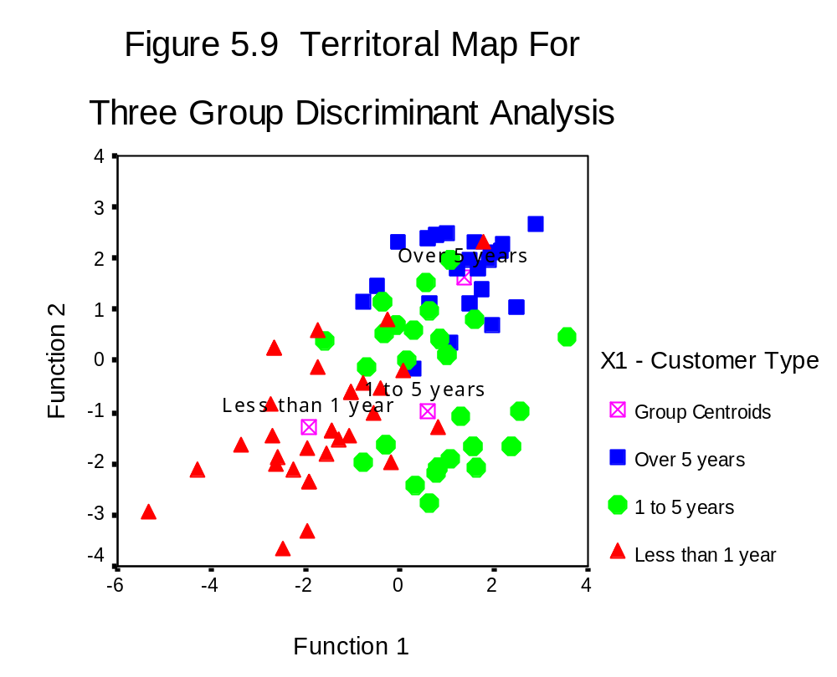
Territorial Map for Three Group Discriminant Analysis

Slide 29
Rules of Thumb 5–4
Interpreting and Validating Discriminant Functions
Discriminant loadings are the preferred method to assess the contribution of each variable to a discriminant function because they are:
  a standardized measure of importance (ranging from 0 to 1).
  available for all independent variables whether used in the estimation process or not.
  unaffected by multicollinearity.
Loadings exceeding ±.40 are considered substantive for interpretation purposes.
If there is more than one discriminant function, be sure to:
  use rotated loadings.
  assess each variable’s contribution across all the functions with the potency index.
The discriminant function must be validated either with a holdout sample or one of the “Leave one out” procedures.

Slide 30
Stage 6: Validation of the Results
Utilizing a Holdout Sample.
Cross-Validation

Slide 31
Discriminant Analysis Learning Checkpoint
When should multiple discriminant analysis be used?
What are the major considerations in the application of discriminant analysis?
Which measures are used to assess the validity of the discriminant function?
How should you identify variables that predict
group membership well?

Slide 32
Description of HBAT Primary Database Variables
Variable Description Variable Type
Data Warehouse Classification Variables
X1 Customer Type nonmetric
X2 Industry Type nonmetric
X3 Firm Size nonmetric
X4 Region nonmetric
X5 Distribution System nonmetric
Performance Perceptions Variables
X6 Product Quality metric
X7 E-Commerce Activities/Website metric
X8 Technical Support metric
X9 Complaint Resolution metric
X10 Advertising metric
X11 Product Line metric
X12 Salesforce Image metric
X13 Competitive Pricing metric
X14 Warranty & Claims metric
X15 New Products metric
X16 Ordering & Billing metric
X17 Price Flexibility metric
X18 Delivery Speed metric
Outcome/Relationship Measures
X19 Satisfaction metric
X20 Likelihood of Recommendation metric
X21 Likelihood of Future Purchase metric
X22 Current Purchase/Usage Level metric
X23 Consider Strategic Alliance/Partnership in Future nonmetric

Slide 33
Logistic Regression Defined
Logistic Regression . . . is a specialized form of regression that is designed to predict and explain a binary (two-group) categorical variable rather than a metric dependent measure. Its variate is similar in form to regular regression. It is less affected than discriminant analysis when the basic assumptions, particularly normality of the independent variables, are not met.

Slide 34
Logistic Regression May Be Preferred . . .
When the dependent variable has only two groups, logistic regression may be preferred for two reasons:
Discriminant analysis relies on strictly meeting the assumptions of multivariate normality and equal variance–covariance matrices across groups, and these assumptions are not met in many situations. Logistic regression does not face these strict assumptions and is much more robust when these assumptions are not met, making its application appropriate in many situations.
Even if the assumptions are met, many researchers prefer logistic regression because it is similar to multiple regression. It has straightforward statistical tests, similar approaches to incorporating metric and nonmetric variables and nonlinear effects, and a wide range of diagnostics.

Slide 35
Unique Nature of the Dependent Variable
The binary nature of the dependent variable (0 – 1) means the error term has a binomial distribution instead of a normal distribution, and it thus invalidates all testing based on the assumption of normality.
The variance of the dichotomous variable is not constant, creating instances of heteroscedasticity as well.
Neither of the above violations can be remedied through transformations of the dependent or independent variables. Logistic regression was developed to specifically deal with these issues.

Slide 36
Estimating the Coefficients
The estimation process has two basic steps:
  Restating a probability as odds, and
  Calculating the logit values.
Instead of using ordinary least squares to estimate the model, the maximum likelihood method is used.

Slide 37
Between Model comparisons . . .
Comparisons of the likelihood values follow three steps:
Estimate a Null Model – which acts as the “baseline” for making comparisons of improvement in model fit.
Estimate Proposed Model – the model containing the independent variables to be included in the logistic regression.
Assess – 2LL Difference.

Slide 38
Comparison to Multiple Regression . . .
Correspondence of Primary Elements of Model Fit
Multiple Regression Logistic Regression
Total Sum of Squares -2LL of Base Model
Error Sum of Squares -2LL of Proposed Model
Regression Sum of Squares Difference of -LL for Base and Proposed Models
F test of model fit Chi-square Test of -2LL Difference
Coefficient of determination “Pseudo” R² measures

Slide 39
Directionality of the Relationship
A positive relationship means an increase in the independent variable is associated with an increase in the predicted probability, and vice versa. But the direction of the relationship is reflected differently for the original and exponentiated logistic coefficients.
  Original coefficient signs indicate the direction of the relationship.
  Exponentiated coefficients are interpreted differently since they are the logarithms of the original coefficients and do not have negative values. Thus, exponentiated coefficients above 1.0 represent a positive relationship and values less than 1.0 represent negative relationships.

Slide 40
Magnitude of the Relationship . . .
The magnitude of metric independent variables is interpreted differently for original and exponentiated logistic coefficients:
Original logistic coefficients – are less useful in determining the magnitude of the relationship since the reflect the change in the logit (logged odds) value.
Exponentiated coefficients – directly reflect the magnitude of the change in the odds value. But their impact is multiplicative and a coefficient of 1.0 denotes no change (1.0 times the independent variable = no change).

Slide 41
Rules of Thumb 5–5
Logistic Regression
Logistic regression is the preferred method for two-group (binary) dependent variables due to its robustness, ease of interpretation and diagnostics.
Model significance tests are made with a chi-square test on the differences in the log likelihood values (-2LL) between two models.
Coefficients are expressed in two forms: original and exponentiated to assist in interpretation.
Interpretation of the coefficients for direction and magnitude is:
  Direction can be directly assessed in the original coefficients (positive or negative signs) or indirectly in the exponentiated coefficients (less than 1 are negative, greater than 1 are positive).
  Magnitude is best assessed by the exponentiated coefficient, with the percentage change in the dependent variable shown by (Exponentiated Coefficient – 1.0) * 100.

